Slide 1
Drug Abuse Detection in Twitter-sphere: Graph-Based Approach
Authors: Khaled Mohammed Saifuddin, Mohammed Ifte Khairul Islam, Esra Akbas
Presenter: Khaled Mohammed Saifuddin

Slide 2
Presentation Topic: Drug Abuse Detection in Twitter-sphere: Graph-Based Approach
Drug Abuse
Research scopes in CS domain to detect Drug Abuse
Drug Abuse Detection using Twitter Data
Different approaches to construct text-graph from Twitter data
Graph Neural Networks
Drug Abuse Detection as node classification and graph classification task by exploiting Graph Neural Networks

Slide 3
What is Drug Abuse?????
Drug Abuse:
According to CDC, Drug Abuse is the use of illegal drugs or even prescription drugs in ways other than recommended.
Illegal drugs:
Illicitly manufactured Fentanyl, Heroin, LSD, Marijuana, etc.
prescription drugs:
Opioids
Central Nervous System (CNS)
Stimulants

Slide 4
Consequences of Drug Abuse
Brain damage, memory loss, attention difficulties
Cancer
Cardiac Arrest
Cardiovascular Disease
Liver, lung, and Kidney Disease
Respiratory arrest
Stroke and
Even Death

Slide 5
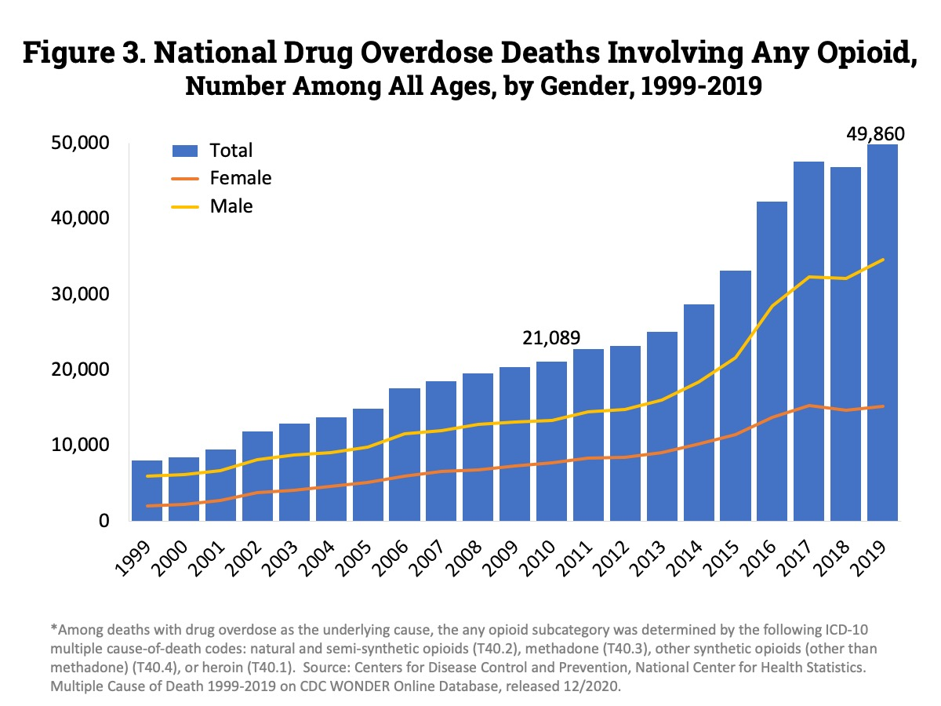
Consequences…:

Slide 6
Drug Abuse Detection: Approaches
Survey-based system:
National Poisoning Data System (NPDS), Centers for Disease Control and Prevention (CDC), and Drug Abuse Warning Network (DAWN), etc.
Problem: Failed to report in real-time
Reluctance of sharing drug abuse information due to potential social stigma and defame.
What could be the solution???

Slide 7
Solution
Social Media Data:
Has become a significant platform for information sharing.
Drug-addicted people willingly share their problems and personal things on social media.
Real-time data that helps us to monitor and detect DA events in real-time.
Problem: Not possible to manually curate information from large volumes of data
What could be the solution???

Slide 8
Solutions
Rule-based approach:
Some researchers detected DA events using a rule-based concept with a dictionary of words.
Drugs | Abuse terms
Fentanyl, Morphine, Oxycodone, Hydrocodone, Hydromorphone, etc. | Overdose, High, Addiction, Abuse, Stoned, Blunt, etc.
Problem: However, this is not efficient due to the huge use of informal and slang terms on social media by users.

Slide 9
Solutions
Machine learning-based model:
Some researchers have considered this problem as a text classification problem and explore different machine learning models in this domain.
Problem: The selection of the best feature.
Deep learning-based model:
Deep learning models, which can learn features automatically like: RNN (LSTM, BiLSTM , GRU), CNN, etc.
Problem: Fail to capture global word co-occurrences when there are very long-distance dependencies

Slide 10
Graph

Slide 11
Graph consists of a set of nodes V and edges E.
Nodes: Real-life entity like social media users
Edges: Nodes are connected through edges.
Here, we construct text graph from Twitter data
where nodes are tweets or words of a tweet.

Slide 12
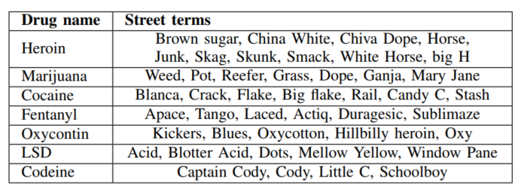
Data Collection
Drug name with street terms:
List of DA indicating terms

Slide 13
Text Graph Construction
There are different ways to create graphs from text.
We construct two different types of text graphs from our corpus:
Corpus-level Text (CT) graph and
Document-level Text(DT) graph.
a) Corpus-level Text (CT) graph:
One single graph from all texts in our corpus.
Each document/tweet as a node of the graph and define relations between them.
Based on the definition of relations
Co-occurrence Graph
Similarity Graph

Slide 14
Co-occurrence graph
Co-occurrence Graph
Documents are similar when words co-occur in them.
we model this document-word co-occurrence relationship as a Bipartite graph, B (two sets of nodes and one set of edge).
Node: Documents and Unique words
Edge: Building edges between nodes based on the TF-IDF score.
From this bipartite graph, we construct 2 different corpus-level text graphs:
a.1.) Homogeneous and,
a.2.) Heterogeneous.

Slide 15
Co-occurrence graph
a.1.) Homogeneous Corpus-level Text (HoCT) graph:
- GHoCT, is a weighted projection graph from the bipartite graph B.
- Homogeneous
a.2.) Heterogeneous Corpus-level Text (HeCT) graph:
- In the bipartite graph, we add word-word edges representing global word co-occurrence in the whole corpus.

Slide 16
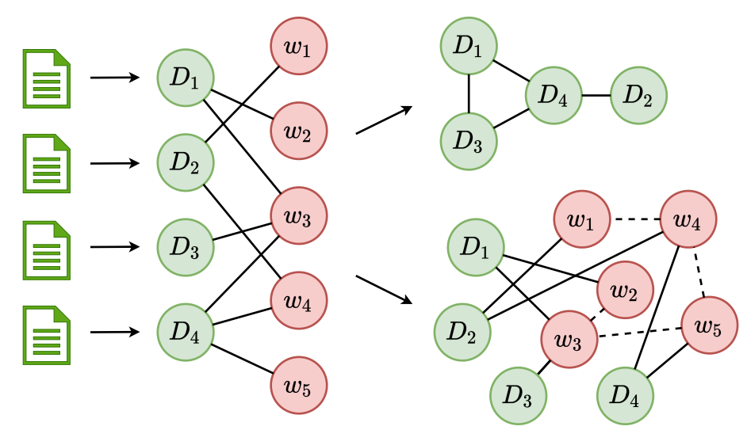
Co-occurrence graph
HoCT
Bipartite
graph
HeCT
Fig. 1: Document-word bipartite graph (left) and its projection to a homogeneous corpus level text graph (right-top) and a heterogeneous corpus level text graph (right-bottom)

Slide 17
Similarity graph
Similarity-based Corpus-level Text (SCT) Graph - Constructing edges between nodes those who have similar latent feature.
- Feature can be computed using Word2Vec, GloVe, etc.
- We then apply the K-nearest neighbors model and build edges among the neighbors.

Slide 18
b) Document-level Text graph
Individual text graphs from each tweet by following two different approaches:
b.1.) Local DT graph and,
b.2.) Global DT graph
b.1.) Local Document-level Text (LDT) Graph:
- In GLDT, each unique word is a node, and build a word-word edge based on the local co- occurrence of words in the tweet for a fixed size sliding window.
b.2.) Global Document-level Text (GDT) Graph:
- We create a U×U global word-word adjacency matrix.
- We add edges between 2 nodes if they appear in the same window in any document even if they do not appear in the same window for that document.

Slide 19
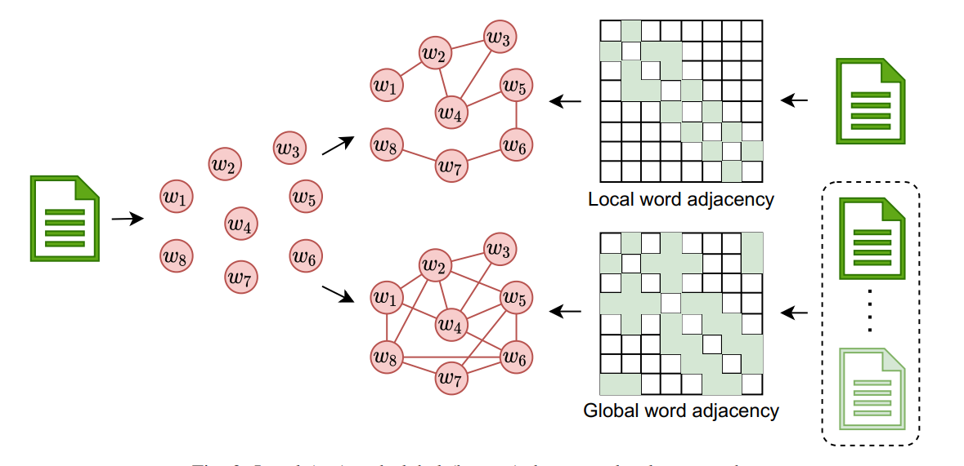
b) Document-level Text graph
LDT
Document
GDT
Fig. 2: Local (top) and global (bottom) document-level text graphs.

Slide 20
Graph Learning

Slide 21
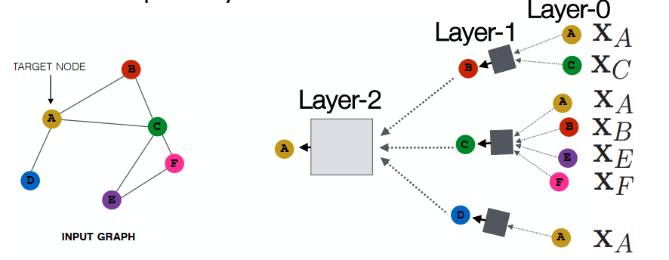
Graph Neural Network
Basic Concept
GNN Architecture
Fig. 3: Graph Neural Network

Slide 22
Graph Neural Network
A layer of a GNN can be expressed as
Where ˆA = adjacency matrix with self-loop,
F(0)∈Rn×m be a matrix containing all n nodes with their features,
W0∈R m×k is a weight matrix,
and σ is an activation function.
Node Embedding:
For corpus-level text (GHoCT, GHeCT, and GSCT), we apply GCN.
Graph Embedding:
For document-level text graphs, we apply Message passing mechanism-based GNN, and Gated graph neural networks on GGDT, and GLDT respectively.

Slide 23
Graph Convolutional Network (GCN)
In GCN, each node is represented by aggregating its neighbors’ features along with its own features.
A two-layer GCN can be expressed as:
Stack of GCN layers
is the normalized symmetric adjacency matrix
A’ = adjacency matrix with 1s on its diagonal for the self-loops.
D’ = degree matrix of A’ where D’ii=∑jA’ij.
F(0)=X, where X is the initial features of nodes
W0 and W1 = trainable weights
A two-layer GCN can capture 2-hop neighbors' information (k=2)

Slide 24
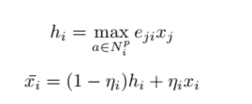
Message Passing Mechanism based GNN (MPM)
MPM applies a reduction function ‘max’, which combines the maximum values on each dimension to form a new vector. Then it updates nodes’ representations based on their original representations and collected information.
Where, hi = messages received from i’s neighbors, Npi is the closest p words of node i, eij is the edge weight between node i and j. max is a reduction function,
Finally, sum up the node level representation to get the graph representation and passed through a softmax function to predict the label of the text.

Slide 25
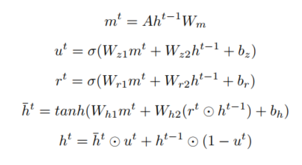
Gated Graph Neural Network (GGNN)
Similar to the MPM, a node receive information from its neighbors and then combine it with its own feature to get updated feature.
ht-1 and ht are the representation of nodes at layer t - 1 and t, respectively u and r are used as update gate and reset gate to determine the degree of neighbors’ information that contributes to the representation of nodes.
Finally, a readout function is used to get the text level representation from nodes.

Slide 26
GNN Learning: Loss Function
Where T = tweets/documents that have labels,
C = dimension of the output features/the number of classes
Y = label matrix
F(2) = embedding of tweets that we get from GNN.

Slide 27
Experiments
Baseline Models:
Rule-based model
Traditional Machine Learning models
Deep learning-based models

Slide 28
1. Rule based model:
We construct a dictionary of words having drug names and abuse words. We go through each tweet and if we find the dictionary words then we label that tweet as DA.
Jaro-Winkler string similarity measure.
2. Traditional Machine Learning Models:
Naive Bayes (NB)
Decision Tree (DT)
Logistic Regression (LR)
3. Deep Learning-based Models:
Convolutional Neural Networks (CNN)
Long Short-Term Memory (LSTM)
Gated Recurrent Unit (GRU)
Recurrent Convolutional Neural Network (RCNN)
Bidirectional LSTM (BiLSTM)

Slide 29
Result Analysis:
1. Rule based model:
2. Traditional Machine Learning Models:
3. Deep Learning-based Models:

Slide 30
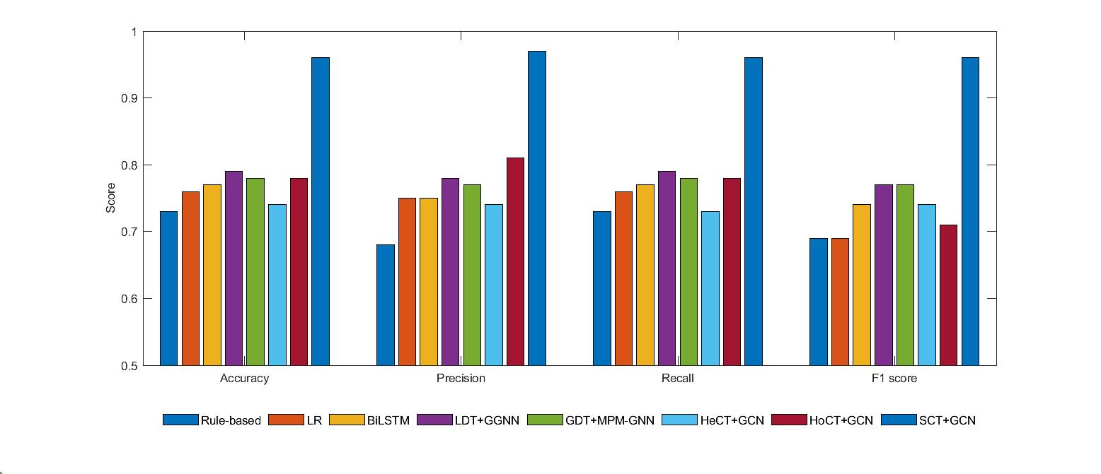
Result Analysis:
Proposed models:
Fig. 4: Comparison between the performance of the proposed graph-based DA detection models and the baseline models. Here we present the best baseline models from each type.

Slide 31
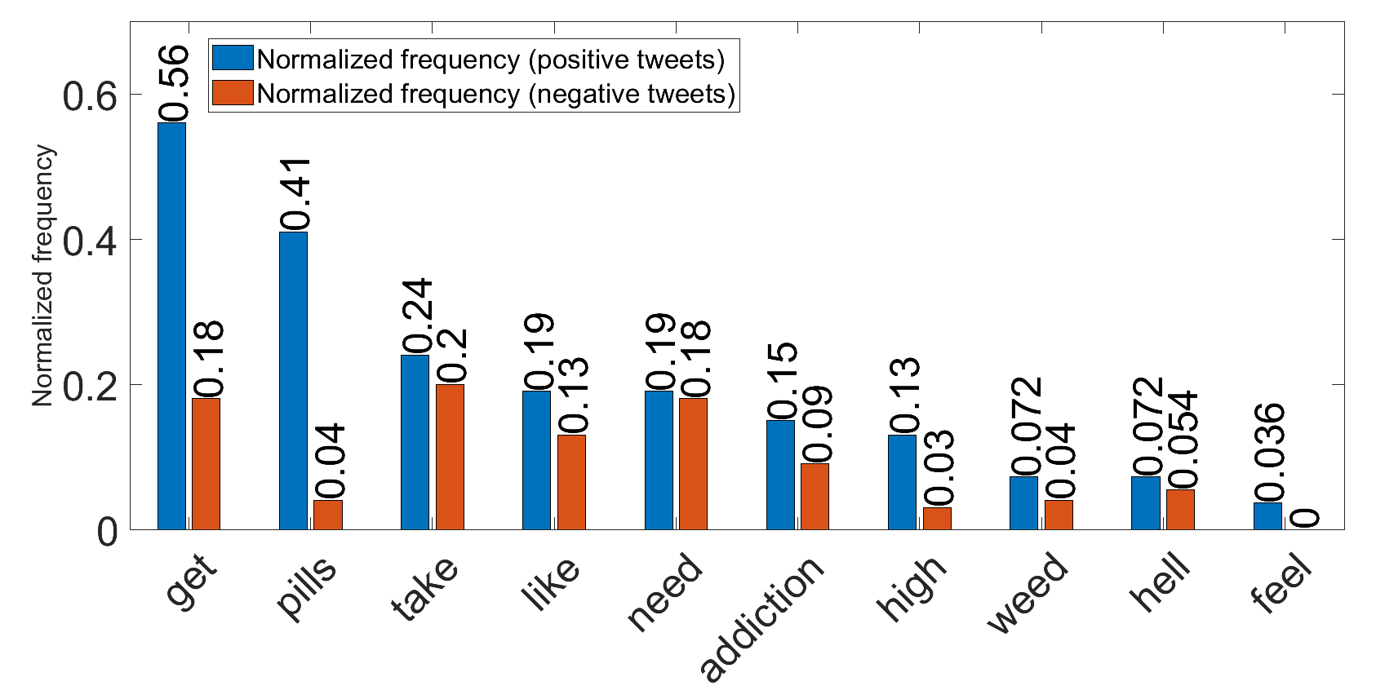
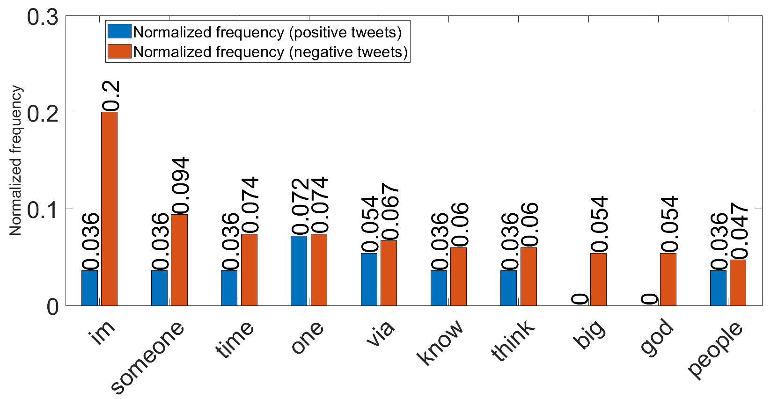
Result Analysis:
Insight analysis on abuse related tweets
Comparison between the normalized frequency score of top 10 frequent words in the positive tweets and the negative tweets.
Comparison between the normalized frequency score of top 10 frequent words in the negative tweets and the positive tweets.
Fig. 5: Insight analysis

Slide 32
Any question???

