Slide 1
Drug-Drug Interaction Prediction: a Purely SMILES Based Approach
Bri Bumgardner*, Farhan Tanvir¶, Khaled Mohammed Saifuddin¶, Esra Akbas¶
*Rice University, ¶Oklahoma State University
Presented by Bri bumgardner

Slide 2
Abstract
Drug-Drug-Interactions (DDI)
What & Why?
Our Research
SMILES strings (Simplified Molecular Input Line-Entry System)
Extract chemical substructures
Graph approach
GNN to generate node embeddings
Concatenate to generate DDIs features
Use ML classifiers for DDI prediction

Slide 3
Brief Overview
Related Work
Methodology
Constructing Graph
Drug Representation Learning
Creating DDI representations
ML with DDI Representations
Results
Conclusion
Q&A
Notes:
Or abstract here?

Slide 4
Related Work
Similarity-based:
Abdelaziz et al., “Large-scale structural and textual similarity-based mining of knowledge graph to predict drug-drug interactions”, 2017.
Classification-based:
B. Davazdahemami and D. Delen, “A chronological pharmacovigilance network analytics approach for predicting adverse drug events,” 2018.
Zheng et. al., “DDI-PULearn: a positive-unlabeled learning method for large-scale prediction of drug-drug interactions”, 2019
NN-based:
M. Zitnik, M. Agrawal, and J. Leskovec, “Modeling polypharmacy side effects with graph convolutional networks,” Bioinform., 2018

Slide 5
Methodology: Broad Overview
Constructing the graph using SMILES strings
Drug representation learning from the graph
Creating DDI representation
Machine Learning with DDI features

Slide 6
1: Create Graph Using SMILES Strings
Key Ideas
Only SMILES information of drugs utilized.
Mine the frequent substructures using ESPF algorithm by Huang et. Al. (Explainable substructure partition fingerprint).
Create graph: nodes are drugs, edges drawn between drugs that share a predetermined number of substuctures (S-Value).

Slide 7
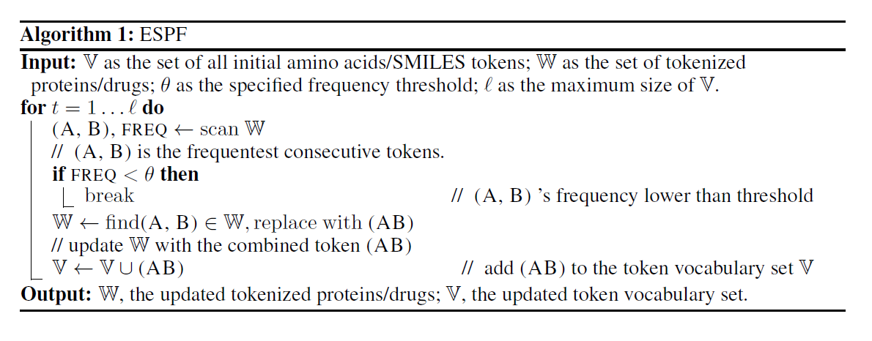
ESPF Algorithm
L. G. J. S. Kexin Huang, Cao Xiao, 2019.

Slide 8
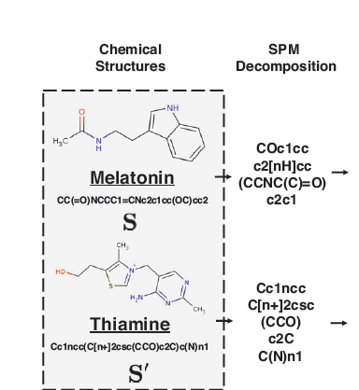
Example of partitioning using ESPF

Slide 9
Graph Details 1.
Drugs used for this paper taken from DrugBank:
FDA approved
DrugBank Data included SMILES strings & at least one DDI with another drug.
Some numbers:
824 drugs total in our dataset with 96,751 known positive interactions.
For ESPF algorithm, we set a freq of 5 occurrences.
After running ESPF, a total of 741 unique substructures found.
Several S-Values used: 2, 3, and 4.

Slide 10
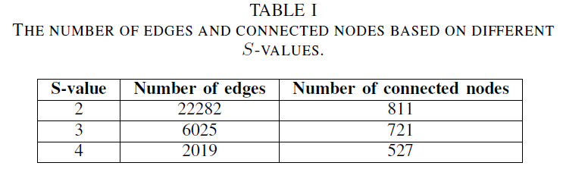
Graph Details 2.
The Graph is weighted with the number of substructures the two nodes share.

Slide 11
2: Drug representation learning from the Graph
For each S-Value, use GNNs on our Graph(s) to generate node embeddings.
Graphsage (GS)
Graph Convolution Network (GCN)
Graph Attention Network (GAT)
For each GNN, two-layer architecture with learning rate, batch size and epochs set to 0.7, 20 and 5, respectively.
Embeddings generated are all 128 bits long.

Slide 12
3: Creating the DDI representations
96, 751 positive interactions given by DrugBank.
Random Selection to generate negative interactions.
Concatenate embeddings from the two drugs involved for each of the positive and negative interactions.
Add a labeling bit 0/1 to indicate the type.
Each DDI represented by a vector of size 257.

Slide 13
Baseline Feature Vector Creation
To compare to the results of our feature vectors, we also create baseline vectors using the method outlined in Huang et al.’s 2020 paper Caster: Predicting drug interactions with chemical substructure representation.
Since we have a total of 741 unique substructures, these representations are of size 742.

Slide 14
4: Machine Learning with DDI features
Binary Classification ML models to learn from the DDI vectors:
K-Nearest Neighbors
Logarithmic Regression
Feed forward Neural Network
70% - 30% Train/Test split of the DDI data
Parameters:
K = 5 for KNN
100 Epochs for NN

Slide 15
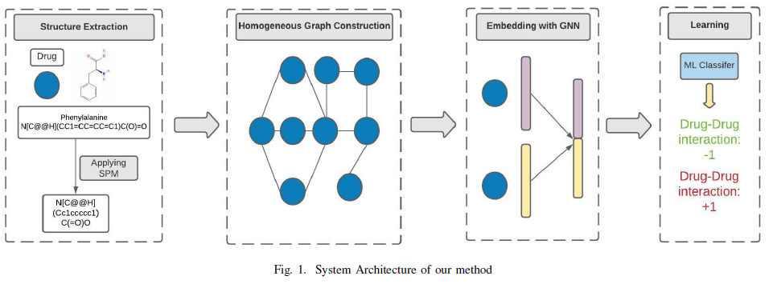

Slide 16
Results
For each combination of the three GNN models and each of the three S-Values, we trained the three mentioned ML models with 70% of our DDI vectors
Each trained model used to classify the remaining 30% of the data. Performance measured using standard methods Accuracy, Precision, Recall and F1-score.

Slide 17
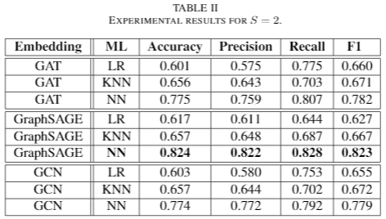
An S-Value of 2 gave the best accuracy across all ML models and embeddings.

Slide 18
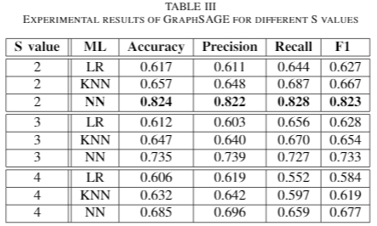
Closer look at GraphSage as highest performing embedding model.

Slide 20
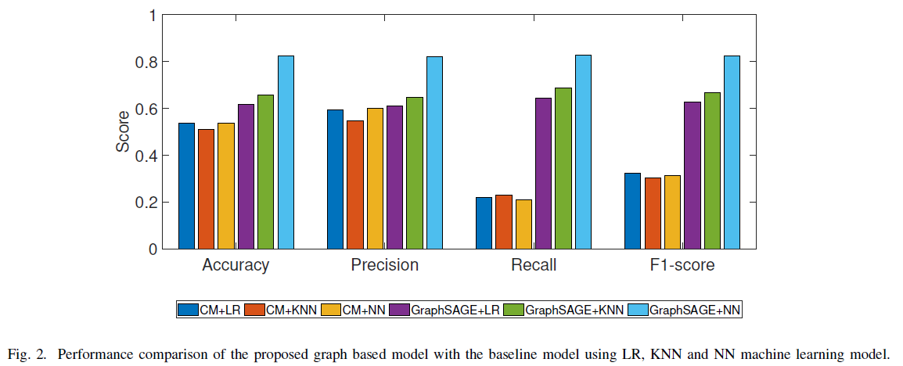

Slide 21
Conclusions
Chemical substructures are critical for DDI prediction
Frequent chemical substructure -> graph superior to similarity measures.
Strong evidence that a method that only relies on the readily available SMILES string information of drugs is viable.
For future work:
Extend our model to predict exact side effect(s) caused by DDIs.
Improve negative pair selection by learning from known non-interacting pairs to generate a set of negative DDIs
Creation of hypergraph from our substructures and using HyperGraph Nueral Network Learning.

Slide 22
Acknowledgements
Dr. Thanh Thieu, for encouraging me to apply for this REU opportunity.
Dr. Esra Akbas, both for her mentorship and encouragement as well as for this amazing opportunity to work in her lab over last summer during my REU at Oklahoma State University.
Farhan Tanvir, who was a huge source of help to me both during my research and writing this paper.
Khaled Mohammed Saifuddin, who also helped me write this paper and shared valuable insight on the more technical aspects.
The Research Experience for Undergraduates (REU) program through the National Science
Foundation grant no. 2050978 for funding this research project.

Slide 23
Q & A

Slide 24
References
I. Abdelaziz, A. Fokoue, O. Hassanzadeh, P. Zhang, and M. Sadoghi, “Large-scale structural and textual similarity-based mining of knowledge graph to predict drug-drug interactions,” J. Web Semant., vol. 44, pp. 104–117, 2017.
B. Davazdahemami and D. Delen, “A chronological pharmacovigilance network analytics approach for predicting adverse drug events,” Journal of the American Medical Informatics Association, vol. 25, p. 1311–1321, 2018.
Y. Zheng, H. Peng, X. Zhang, Z. Zhao, X. Gao, and J. Li, “Ddi-pulearn: a positive-unlabeled learning method for large-scale prediction of drug-drug interactions,” BMC Bioinformatics, vol. 20, 2019.
M. Zitnik, M. Agrawal, and J. Leskovec, “Modeling polypharmacy side effects with graph convolutional networks,” Bioinform., vol. 34, no. 13, pp. i457–i466, 2018. [Online]. Available: https://doi.org/10.1093/bioinformatics/bty294
L. G. J. S. Kexin Huang, Cao Xiao, “Explainable substructure partition fingerprint for protein, drug, and more,” NeurIPS Learning Meaningful Representation of Life Workshop, 2019.
K. Huang, C. Xiao, T. N. Hoang, L. Glass, and J. Sun, “Caster: Predicting drug interactions with chemical substructure representation,” in AAAI, 2020.

