Slide 1
Paper Title: Predicting Drug-Drug Interactions Using Meta-path Based Similarities
Accepted in:18th IEEE International Conference on Computational Intelligence in Bioinformatics and Computational Biology (CIBCB) 2021
Authors: Farhan Tanvir, Muhammad Ifte Khairul Islam, Esra Akbas

Slide 2
Presentation Overview
Motivation
Polypharmacy
Problems caused by Polypharmacy
Drug drug interaction
Existing research
Limitations in existing research
Our approach
Modeling different biomedical entities
Heterogeneous graph
Depicting different, multi-relations
Meta-paths
Meta-path topological features
Experimental setup
Imbalanced data analysis
DDI prediction results comparison with baselines
Future work
Quick Recap
Conclusion

Slide 3
Problems caused by Polypharmacy

Slide 4
Drug drug interaction

Slide 5
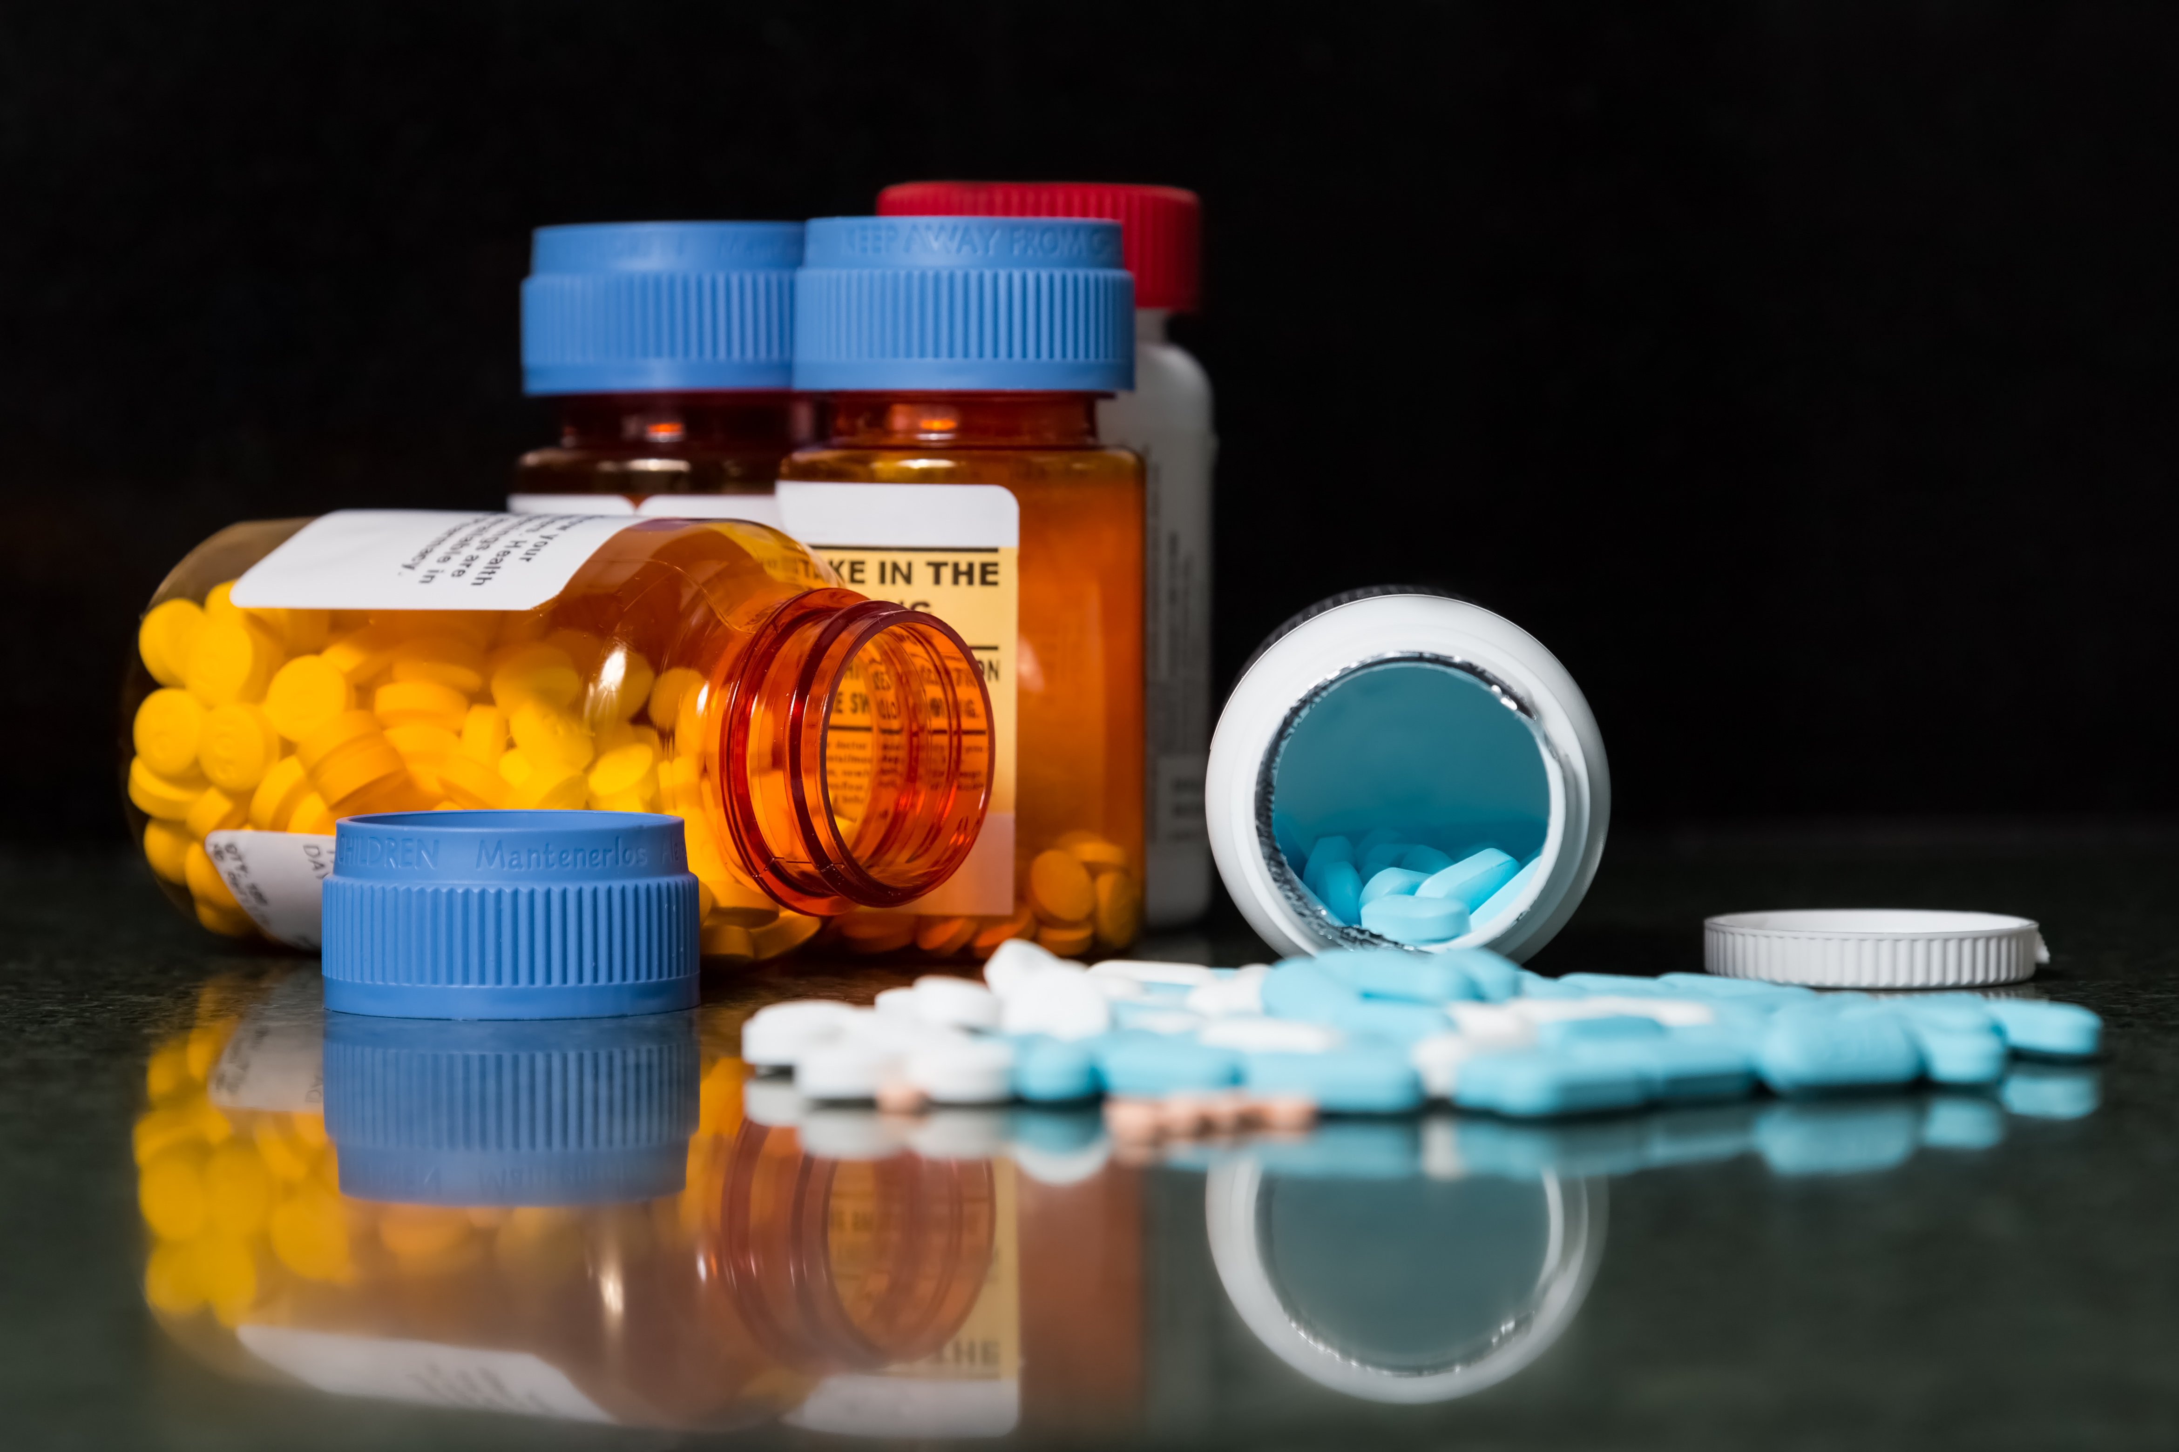
Challenges in clinical trial of drugs
Limited time
Limited number of patients
Inability to test all drug combinations

Slide 6
Existing research
Computational methods:
Classification-based methods:
computes features based on drugs’ interaction with other biomedical entities
predict probability of a drug-drug interactions
Similarity-based methods:
assumption that similar drugs will interact with same drug

Slide 7
Limitations in existing works:
Using limited data sources
Assumption of a balanced data distribution
Not predicting for new drugs
Adopting inappropriate accuracy measures

Slide 8
Our Study
Predict whether drug pairs interact or not
overcome existing works’ limitations

Slide 9
Motivation
The core idea
Similar drugs will interact with the same drug

Slide 10
Problem formulation: Modeling different biomedical entities and relations
Problem
Different type of data: Molecule, pathway, chemical substructure, ATC code, drug and patient data
Data type: Heterogeneous and Distinct
Relation type: multi-relational

Slide 11
Data
DrugBank:
Drug-Protein Interaction,
Protein-Species Interaction,
Drug-Pathway Interaction,
Pathway-Pathway Subject Interaction,
SMILES string,
ATC code
KEGG: SMILES string and ATC code
DEB2: Includes Drug-Indication information
TWOSIDES: Drug-Drug interaction data

Slide 12
Problem formulation: Modeling different biomedical entities

Slide 13
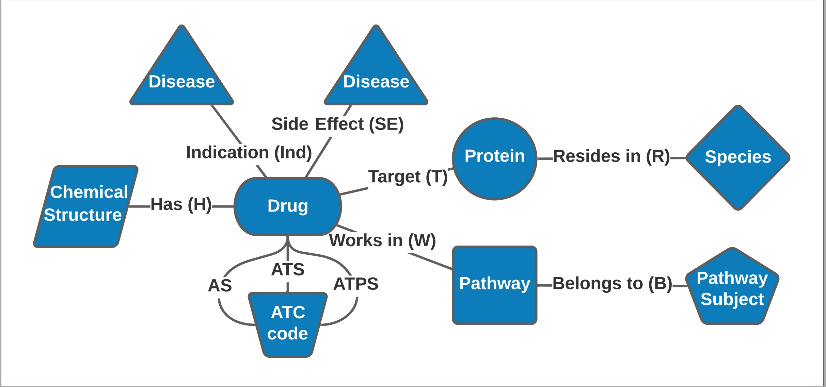
Problem formulation: Modeling different biomedical entities
Our Solution
Build a heterogeneous graph
Consider different biomedical entities as different type of nodes

Slide 14
Problem formulation: Depicting different, multi-relations
We have diverse biomedical entity information.
Interaction data among them are of different types as well.
How to accurately denote relationships among them?

Slide 15
Problem formulation: Depicting different, multi-relations
Thrombin
Coagulation factor XIII A chain
Prothrombin
Two objects can be connected via different connectivity paths
E.g., two drugs can be connected by
“drug-protein-drug” (DPD)
“drug-side effect drug” (DSD)(APCPA)
Meta-path: a sequence of node classes connected by edge types. Meta-paths can be used to define similarity/relevance between 2 nodes.

Slide 16
Problem formulation: Depicting different, multi-relations

Slide 17
Problem formulation: Depicting different, multi-relations
Meta-path topological features:
Computes interconnectedness and relation among drug pairs
Considers structure and connectivity of network
Utilized four topological features
Path count: number of paths following a given meta-path
Normalized path count: path count between two entities divided by total connectivity of each entity instance
Random Walk:
Random one-way walk
Number of path instances between two entities divided by total connectivity of one entity instance
Symmetric Random Walk:
Random two-way walk
Considers connectivity of both entity instances

Slide 18
Our Model
link prediction: predicts whether drug pairs interact or not
experimented with different ML algorithms (SVM, Logistic Regression, Random Forest and Neural network)
selected the best learning algorithm for our model
Create features for drug pairs with meta-paths

Slide 19
Experimental Setup
Experimented for existing and new drugs. In both cases, 80% data is used for training and 20% data is used for testing
New drugs scenario:
20% drugs data don’t appear in training set and only appear in testing
20% drugs can be regarded as new drugs
Existing drugs:
No drug is hidden during testing
all drugs’ data is used for training and testing
Performance are assessed using different evaluation metrics, i.e., F₁ score, Recall, Precision, AUROC and AUPR

Slide 20
Imbalanced data analysis
Considered DDI prevalence in our data ranging from 30-50%
30% DDI prevalence means 30% of data in training and testing set is labeled
For a given DDI prevalence in training data, we produced accuracy results for testing data.

Slide 21
Baseline methods
DeepWalk
widely used as a benchmark in comparison with other graph learning approaches
Graph embedding method which uses random walks. It is based on another popular work word2vec
Computed embedding of drugs from drug-drug interaction matrix
Node2vec
One of the more popular graph learning methods
Like DeepWalk, Node2vec also uses random walks. But it uses 2 parameters during graph traversal
Computed embedding of drugs from drug-drug interaction matrix
Concatenated drug features
constructs a feature vector for each drug based on PCA representation of drug– other biomedical entities interaction matrix (protein, pathway, side effect)
drug pairs are represented by concatenating the corresponding drug feature vectors

Slide 22
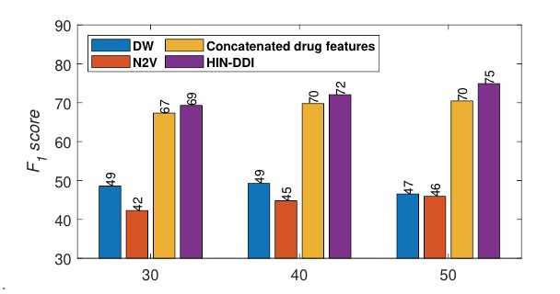
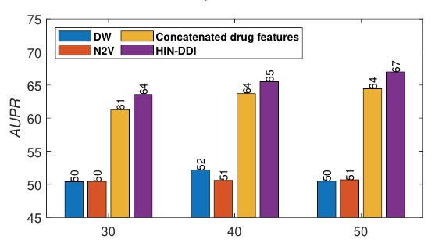
Results: DDI prediction comparison with baselines
Existing and new drugs
HIN-DDI surpasses best-performing baseline methods by ~11%.
It performs superior results to one baseline by 63%

Slide 23
Future work
Limitations
No weights/attention used to quantify more important meta-paths
Some datasets may not contain complete information for all drugs. Integrating these dataset might result in inconsistent, incomplete data.
Use weights to identify important meta-paths
focus on fewer datasets which has complete drug-centric information.
Meta-graphs are capable for extracting complex relations compared to meta-paths. It can be utilized in future works.

Slide 24
Quick Recap

Slide 25
Conclusion
Novel method for DDI prediction
Addressed existing shortcomings in prior works

Slide 26
Any Questions?

Slide 27
References
Chiang, W., Shen, L., Li, L., & Ning, X. (2018). Drug Recommendation toward Safe Polypharmacy. ArXiv, abs/1803.03185.
Zitnik, M., & Zupan, B. (2016). COLLECTIVE PAIRWISE CLASSIFICATION FOR MULTI-WAY ANALYSIS OF DISEASE AND DRUG DATA. Pacific Symposium on Biocomputing. Pacific Symposium on Biocomputing, 21, 81–92.
Fu, G., Ding, Y., Seal, A., Chen, B., Sun, Y., & Bolton, E. (2016). Predicting drug target interactions using meta-path-based semantic network analysis. BMC Bioinformatics, 17.
Zheng, Y., Peng, H., Zhang, X. et al. DDI-PULearn: a positive-unlabeled learning method for large-scale prediction of drug-drug interactions. BMC Bioinformatics 20, 661 (2019). https://doi.org/10.1186/s12859-019-3214-6
Gottlieb, A., Stein, G. Y., Oron, Y., Ruppin, E., & Sharan, R. (2012). INDI: a computational framework for inferring drug interactions and their associated recommendations. Molecular systems biology, 8, 592. https://doi.org/10.1038/msb.2012.26
Zhang, P., Wang, F., Hu, J. et al. Label Propagation Prediction of Drug-Drug Interactions Based on Clinical Side Effects. Sci Rep 5, 12339 (2015). https://doi.org/10.1038/srep12339
Vilar, S., Uriarte, E., Santana, L., Lorberbaum, T., Hripcsak, G., Friedman, C., & Tatonetti, N. P. (2014). Similarity-based modeling in large-scale prediction of drug-drug interactions. Nature protocols, 9(9), 2147–2163. https://doi.org/10.1038/nprot.2014.151
Ibrahim Abdelaziz, Achille Fokoue, Oktie Hassanzadeh, Ping Zhang, and Mohammad Sadoghi. 2017. Large-scale structural and textual similarity-based mining of knowledge graph to predict drug-drug interactions. Web Semant 44, C (May 2017), 104-117. https://doi.org/10.1016/j.websem.2017.06.002
Davazdahemami, B., & Delen, D. (2018). A chronological pharmacovigilance network analytics approach for predicting adverse drug events. Journal of the American Medical Informatics Association : JAMIA, 25(10), 1311–1321. https://doi.org/10.1093/jamia/ocy097
Zitnik, M., Agrawal, M., & Leskovec, J. 2018. Modeling polypharmacy side effects with graph convolutional networks. Bioinformatics, 34, i457 - i466. https://doi.org/10.1093/bioinformatics/bty294
He, L., Yang, Z., Zhao, Z., Lin, H., & Li, Y. (2013). Extracting drug-drug interaction from the biomedical literature using a stacked generalization-based approach. PloS one, 8(6), e65814. https://doi.org/10.1371/journal.pone.0065814
Tatonetti, N., Denny, J., Murphy, S., Fernald, G., Krishnan, G., Castro, V., Yue, P., Tsau, P., Kohane, I., Roden, D., & Altman, R. (2011). Detecting Drug Interactions From Adverse‐Event Reports: Interaction Between Paroxetine and Pravastatin Increases Blood Glucose Levels. Clinical Pharmacology & Therapeutics, 90.
Grover, Aditya and J. Leskovec. “node2vec: Scalable Feature Learning for Networks.” Proceedings of the 22nd ACM SIGKDD International Conference on Knowledge Discovery and Data Mining(2016): n. pag.
Perozzi, Bryan, Rami Al-Rfou and S. Skiena. “DeepWalk: online learning of social representations.” Proceedings of the 20th ACM SIGKDD international conference on Knowledge discovery and data mining (2014): n. pag.
Fan, Yujie, Yiming Zhang, Yanfang Ye, Xin Li and Wanhong Zheng. “Social Media for Opioid Addiction Epidemiology: Automatic Detection of Opioid Addicts from Twitter and Case Studies.” Proceedings of the 2017 ACM on Conference on Information and Knowledge Management(2017): n. pag.
Fan, Yujie, Yiming Zhang, Yanfang Ye and Xin Li. “Automatic Opioid User Detection from Twitter: Transductive Ensemble Built on Different Meta-graph Based Similarities over Heterogeneous Information Network.” IJCAI (2018).
Mikolov, Tomas, Ilya Sutskever, Kai Chen, G. Corrado and J. Dean. “Distributed Representations of Words and Phrases and their Compositionality.” NIPS (2013).

Slide 28
Results: DDI prediction comparison with baselines
Existing drugs
HIN-DDI surpasses best-performing baseline methods by 10%.
It performs superior results to one baseline by 63%

Slide 29
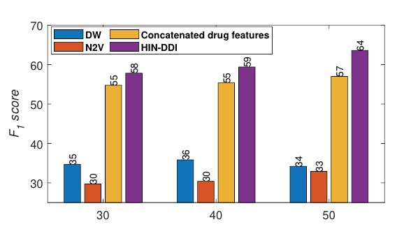
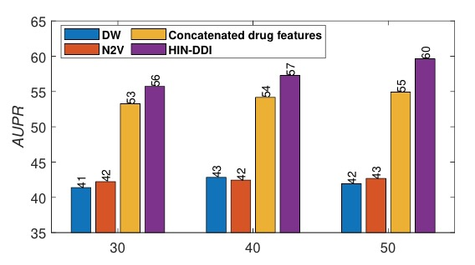
Results: DDI prediction comparison with baselines
New Drugs
HIN-DDI achieves better accuracy results than best baseline methods by 11%.
It’s performance for new drugs is close to that of existing drugs.
Overcomes prior works’ inability to predict for new drugs

Slide 30
Results: Detailed analysis on meta-paths
Analyzed impact of each feature by performing extensive experiments
Target protein, pathway, chemical substructure and side effect determined prediction efficiency. These can be considered as core features
ATC code and indication play negligible role in DDI prediction

